Slide 1
Defining Patriotism

Slide 2
Lesson Purpose
This lesson discusses some of the symbols that represent the United States.

Slide 3

Lesson Objectives
Define Patriotism.
List characteristics of a patriot.
Explain why certain symbols carry a patriotic connotation.
Apply a definition to a list of actions to determine if the action was patriotic.

Slide 4
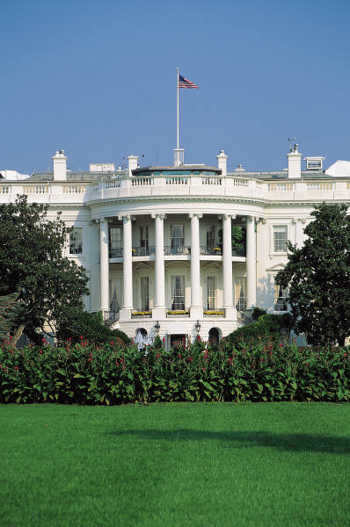
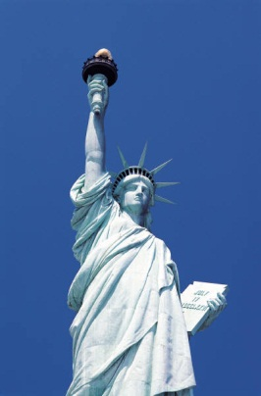
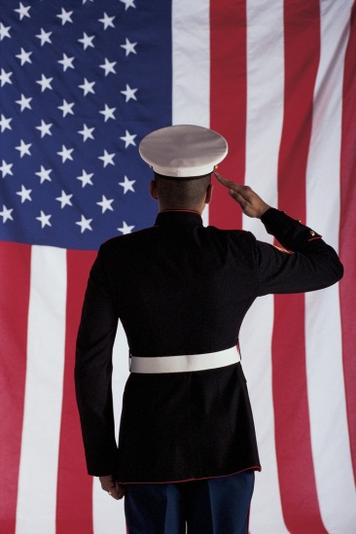
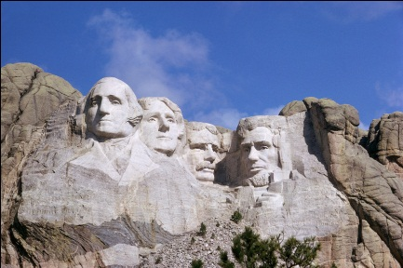
Introduction
Many different symbols have special patriotic feelings for millions of Americans.
This makes the definition of patriotism different for everyone.

Slide 5
Old Glory
In 1818, Congress declared that the U.S. Flag would return to 13 stripes to represent the 13 original colonies and a star added for each new state on the fourth of July after its admission into the Union.
There are strict rules on how the flag should be properly displayed, cared for, and used.

Slide 6
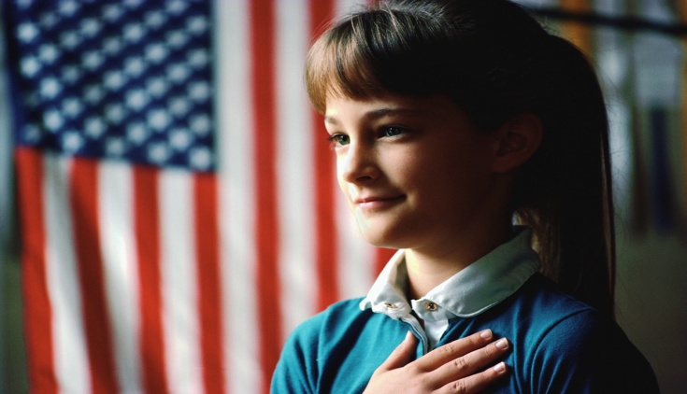
The Pledge of Allegiance
  The Pledge was first used in public schools in celebration of Columbus Day, October 12, 1892.
Congress adopted the pledge in an act approved on June 22, 1942.

Slide 7
The National Anthem
  Francis Scott Key wrote a poem called “The Defense of Fort McHenry” due to his pride in the United States for winning the battle for Baltimore, Maryland.
  The poem was later put to music and became known as ______________________.
  In 1931, Congress confirmed this was the United States’ national anthem.
The Star-Spangled Banner

Slide 8
The National Anthem
  “Oh, say can you see by the dawn's early light,
  What so proudly we hailed at the twilight's last gleaming?
  Whose broad stripes and bright stars thru the perilous fight,
  O'er the ramparts we watched were so gallantly streaming?
  And the rocket's red glare, the bombs bursting in air,
  Gave proof through the night that our flag was still there.
  Oh, say does that star-spangled banner yet wave
  O'er the land of the free and the home of the brave?”
Click here to start audio

Slide 9
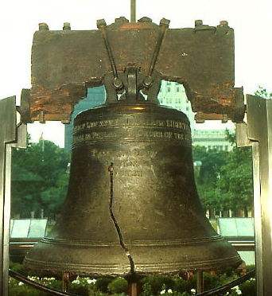
The Liberty Bell
The Liberty Bell was rung in July 1776 to announce the adoption of the ________________________.
Declaration of Independence
After the bell cracked for a second time during Chief John Marshall’s funeral, the bell was silenced.
In about 1839, it became known as the Liberty Bell when people advocating the abolition of slavery used it as a symbol.

Slide 10
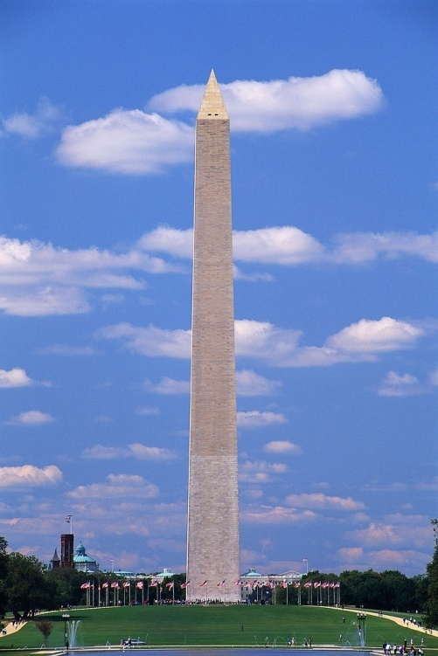
The Washington Monument
The Washington Monument is almost ____ feet tall.
The monument is a symbol for our respect for President George Washington.
556

Slide 11

Which action of the United States stirs up the strongest feelings of patriotism in you? Why?
(LE1-C2S1T1:LQ8)
Revolutionary war against England to make us a free country
Abolition of slavery (Civil War)
The right of women to vote (Suffrage)
Iraq War (Bringing freedom to the people of Iraq)
Other

Slide 12

Which of the following aspects of being an American make you feel the most patriotic (that is, proud to be an American)? Why?
(LE1-C2S1T1:LQ9)
The freedoms that I have such as freedom of religion and the right to bear arms
That so many have died to guarantee my freedoms
That our country has a free press
That in our country no one is above the law
Other

Slide 13
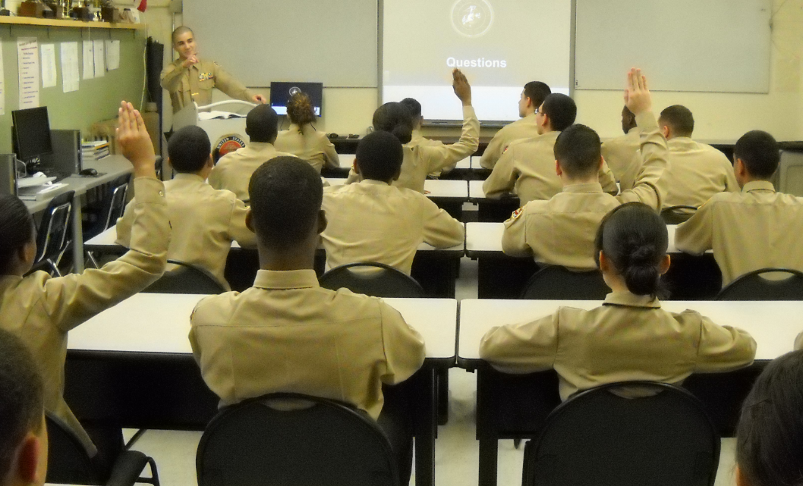
Questions

Slide 14
Whiteboard

